Slide 1

Chain Research
Consumer Research & Surveys made more Trustable and Secure

Slide 2
Why do companies conduct surveys and research ?
Identify potential new customers.
Understand your current customers.
Prepare for possible business expansion.
Identify new business opportunities.
Test your hypotheses before building a product.

Slide 3
Problem
Hard to detect fake users.
User can do fraudulent and duplicate submissions.
Not much incentives to the surveyee.
Surveyor can manipulate the data.
Hard to reach true end users for the user research.

Slide 4
Current Landscape
eMail surveys cost around $5,000 - $7,000.
Cost for 200 phone surveys is around $5,000-$15,000.
$40 to $100 for 15 min video
The global revenue of the market research industry exceeded 44 billion U.S. dollars in 2015.
Organizations have to helplessly trust the Marketing-Research Agencies with inadequate Authenticity, inspite of spending so much.
Notes:
https://smallbusiness.chron.com/key-costs-benefits-marketing-research-26311.html
https://www.quora.com/Who-are-the-best-agencies-in-the-Bay-Area-for-doing-user-experience-audits-on-an-existing-website

Slide 5

Chain Research
The Solution
A novel way of doing market and user research. Keeping user and org. data on blockchain.

Slide 6
How it works
Step 2
Step 3
Step 1
SME prepares questionnaire,
XX rCoin in Escrow to accept questionnaire in BlockChain
Ask for Mkt. Research or UX Research
Orgs/ Mkt. Research Agencies
Mkt Research / Chain Research
Chain Research

Slide 7
How it works
Step 5
Step 6
Step 4
User get XX coin to response to survey. Full control of what they share
Results submitted to the Corporate. Escrow Coin Released
Coin Research DApp BASE authentication
Coin Research Dapp
User
Corporate/org

Slide 8
Why blockchain ?
Transactions are verified.
Transparency and trust.
Data submitted by user is Immutable so surveyer can’t manipulate data.
Easy to incentivize end users.
Highly secure.
Transactions are easily traceable.

Slide 9
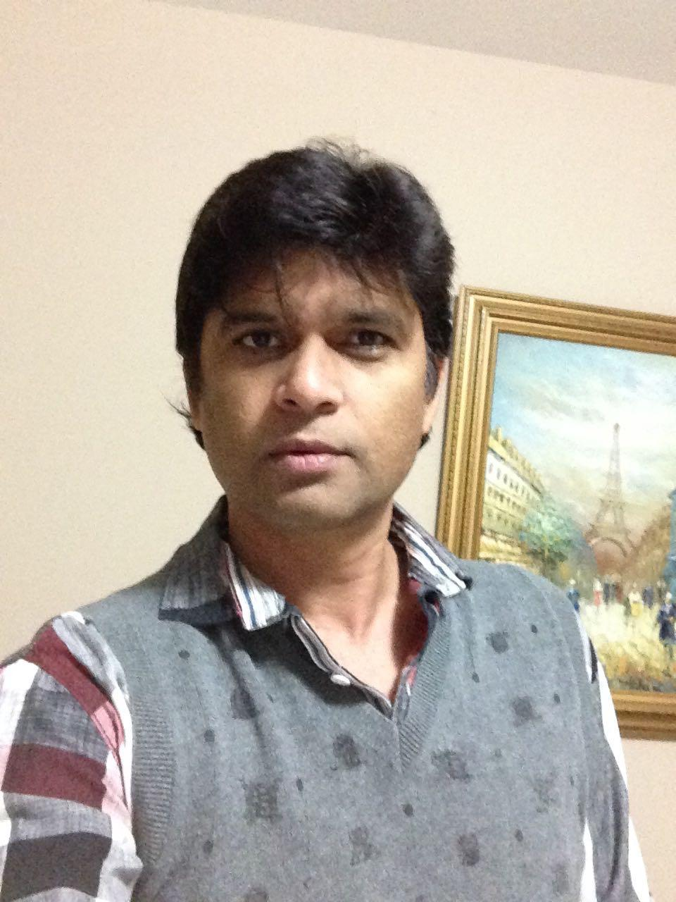
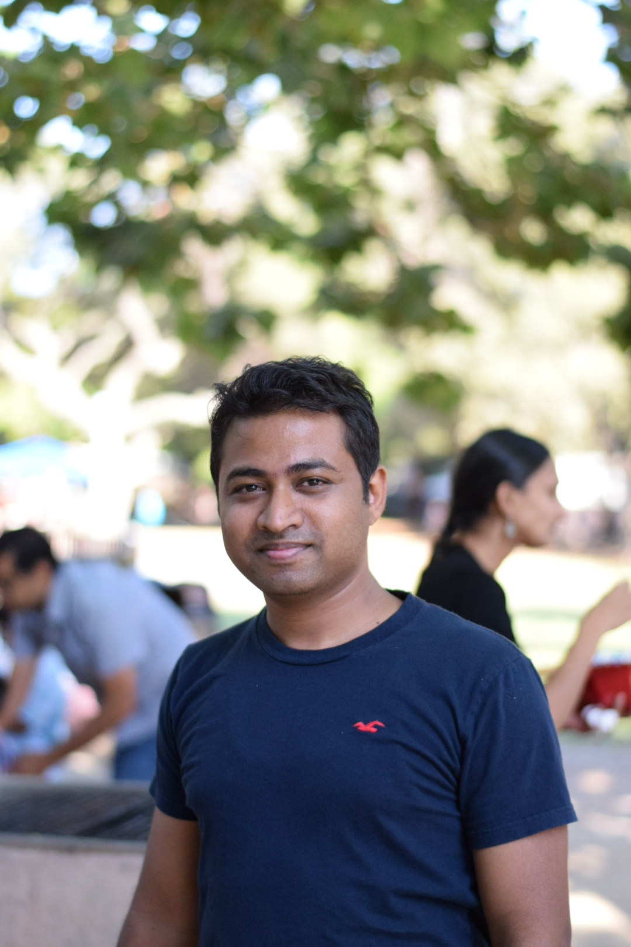

The team
Vikas Singh
Jagadish
Gaurav
Jay
Software Engineer Blockchain enthusiast
Software Engineer Expert in consumer products
Engineer@Google
Grad student@Stanford
Blockchain enthusiast
Blockchain Consultant with Datascience & AI background

Slide 10
Architecture
Permissioned Blockchain
User
Hashed Identity- BASE
Dist.
Ledger
+
chaincode
Dist.
Ledger
+
chaincode
Dist.
Ledger
+
chaincode
Agency
Full access
Company
Full access
Permissioned Blockchain

Slide 11
Technologies
BASE API
Hyperledger Fabric
Hyperledger Composer & Playground
Chaincode in Java Script
Angular UI

